Slide 1
Sorting
Taking an arbitrary permutation of n items and rearranging them into total order
Sorting is, without doubt, the most fundamental algorithmic problem
Supposedly, between 25% and 50% (depending on source) of all CPU cycles are spent sorting
used in office apps (databases, spreadsheets, word processors,...)
Sorting is fundamental to most problems, for example binary search.
Many different approaches lead to useful sorting algorithms
Generally it helps to know about the properties of data to be sorted so we can sort it faster.

Slide 2
Applications of Sorting
Sorting: important because once list is sorted, other problems become easy.
Searching
Speeding up searching is perhaps the most important application of sorting.
Closest pair
Given n numbers, find the pair which are closest to each other.
Once a list is sorted, how long will this take?
Element uniqueness
Given a set of n items, are they all unique? Remove duplicates.
Sorted list versus unsorted list?
Set differences:
Compare 2 large sets and find where they differ
Frequency distribution mode
Given a set of n items, which element occurs the largest number of times?
Median and Selection
What is the kth largest item in the set? The median element?

Slide 3
Selection Sort
Your basic sorting algorithm
Straightforward
How do we do this?

Slide 4
Selection Sort Example
35 65 30 60 20 scan 0-4, smallest=20
swap 35 and 20
20 65 30 60 35 scan 1-4, smallest=30
swap 65 and 30
20 30 65 60 35 scan 2-4, smallest=35
swap 65 and 35
20 30 35 60 65 scan 3-4, smallest=60
swap 60 and 60
30 35 60 65 done
Algorithm design?

Slide 5
Selection Sort Algorithm
for i = 0 to n-2 do // steps 2-6 form a pass
set min_pos to i
for j = i+1 to n-1 do
if item at j < item at min_pos
set min_pos to j
Exchange item at min_pos with one at i

Slide 6
Bubble Sort
Compares adjacent array elements
Exchanges their values if they are out of order
Smaller values bubble up to the top of the array
Larger values sink to the bottom

Slide 7
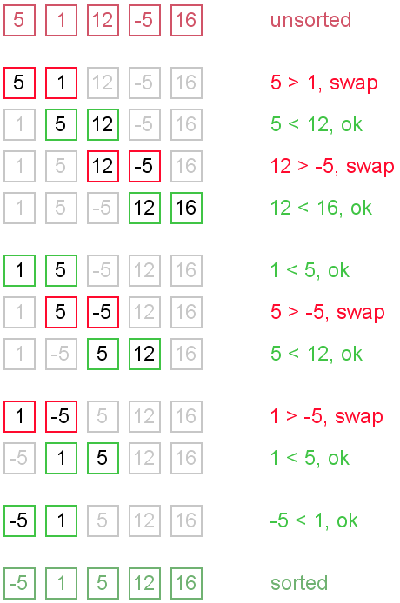
BubbleSort

Slide 8
Bubble Sort Algorithm
do
for each pair of adjacent array elements
if values are out of order
Exchange the values
while the array is not sorted

Slide 9
Bubble Sort Algorithm, Refined
do
Initialize exchanges to false
for each pair of adjacent array elements
if values are out of order
Exchange the values
Set exchanges to true
while exchanges

Slide 10
Bubble Sort Code
void bubble_sort(int first, int last, int arr[]) {
int pass = 1;
bool exchanges;
do {
exchanges = false; // No exchanges yet.
// Compare each pair of adjacent elements.
for (int x = first; x != last - pass; x++) {
int y = x + 1;
if (arr[y] < arr[x]) { // Exchange pair.
int temp = arr[y];
arr[y] = arr[x];
arr[x] = temp;
exchanges = true; // Set flag.
}
}
pass++;
} while (exchanges);
}

Slide 11
Analysis of Bubble Sort
Is this better than selection sort?
In what cases would this algorithm work best?
Worst?

Slide 12
Analysis of Bubble Sort
Excellent performance in some cases
But very poor performance in others!
Works best when array is nearly sorted to begin with
Worst case number of comparisons: O(n²)
Worst case number of exchanges: O(n²)
Best case occurs when the array is already sorted:
O(n) comparisons
O(1) exchanges (none actually)
Can we do better?

Slide 13
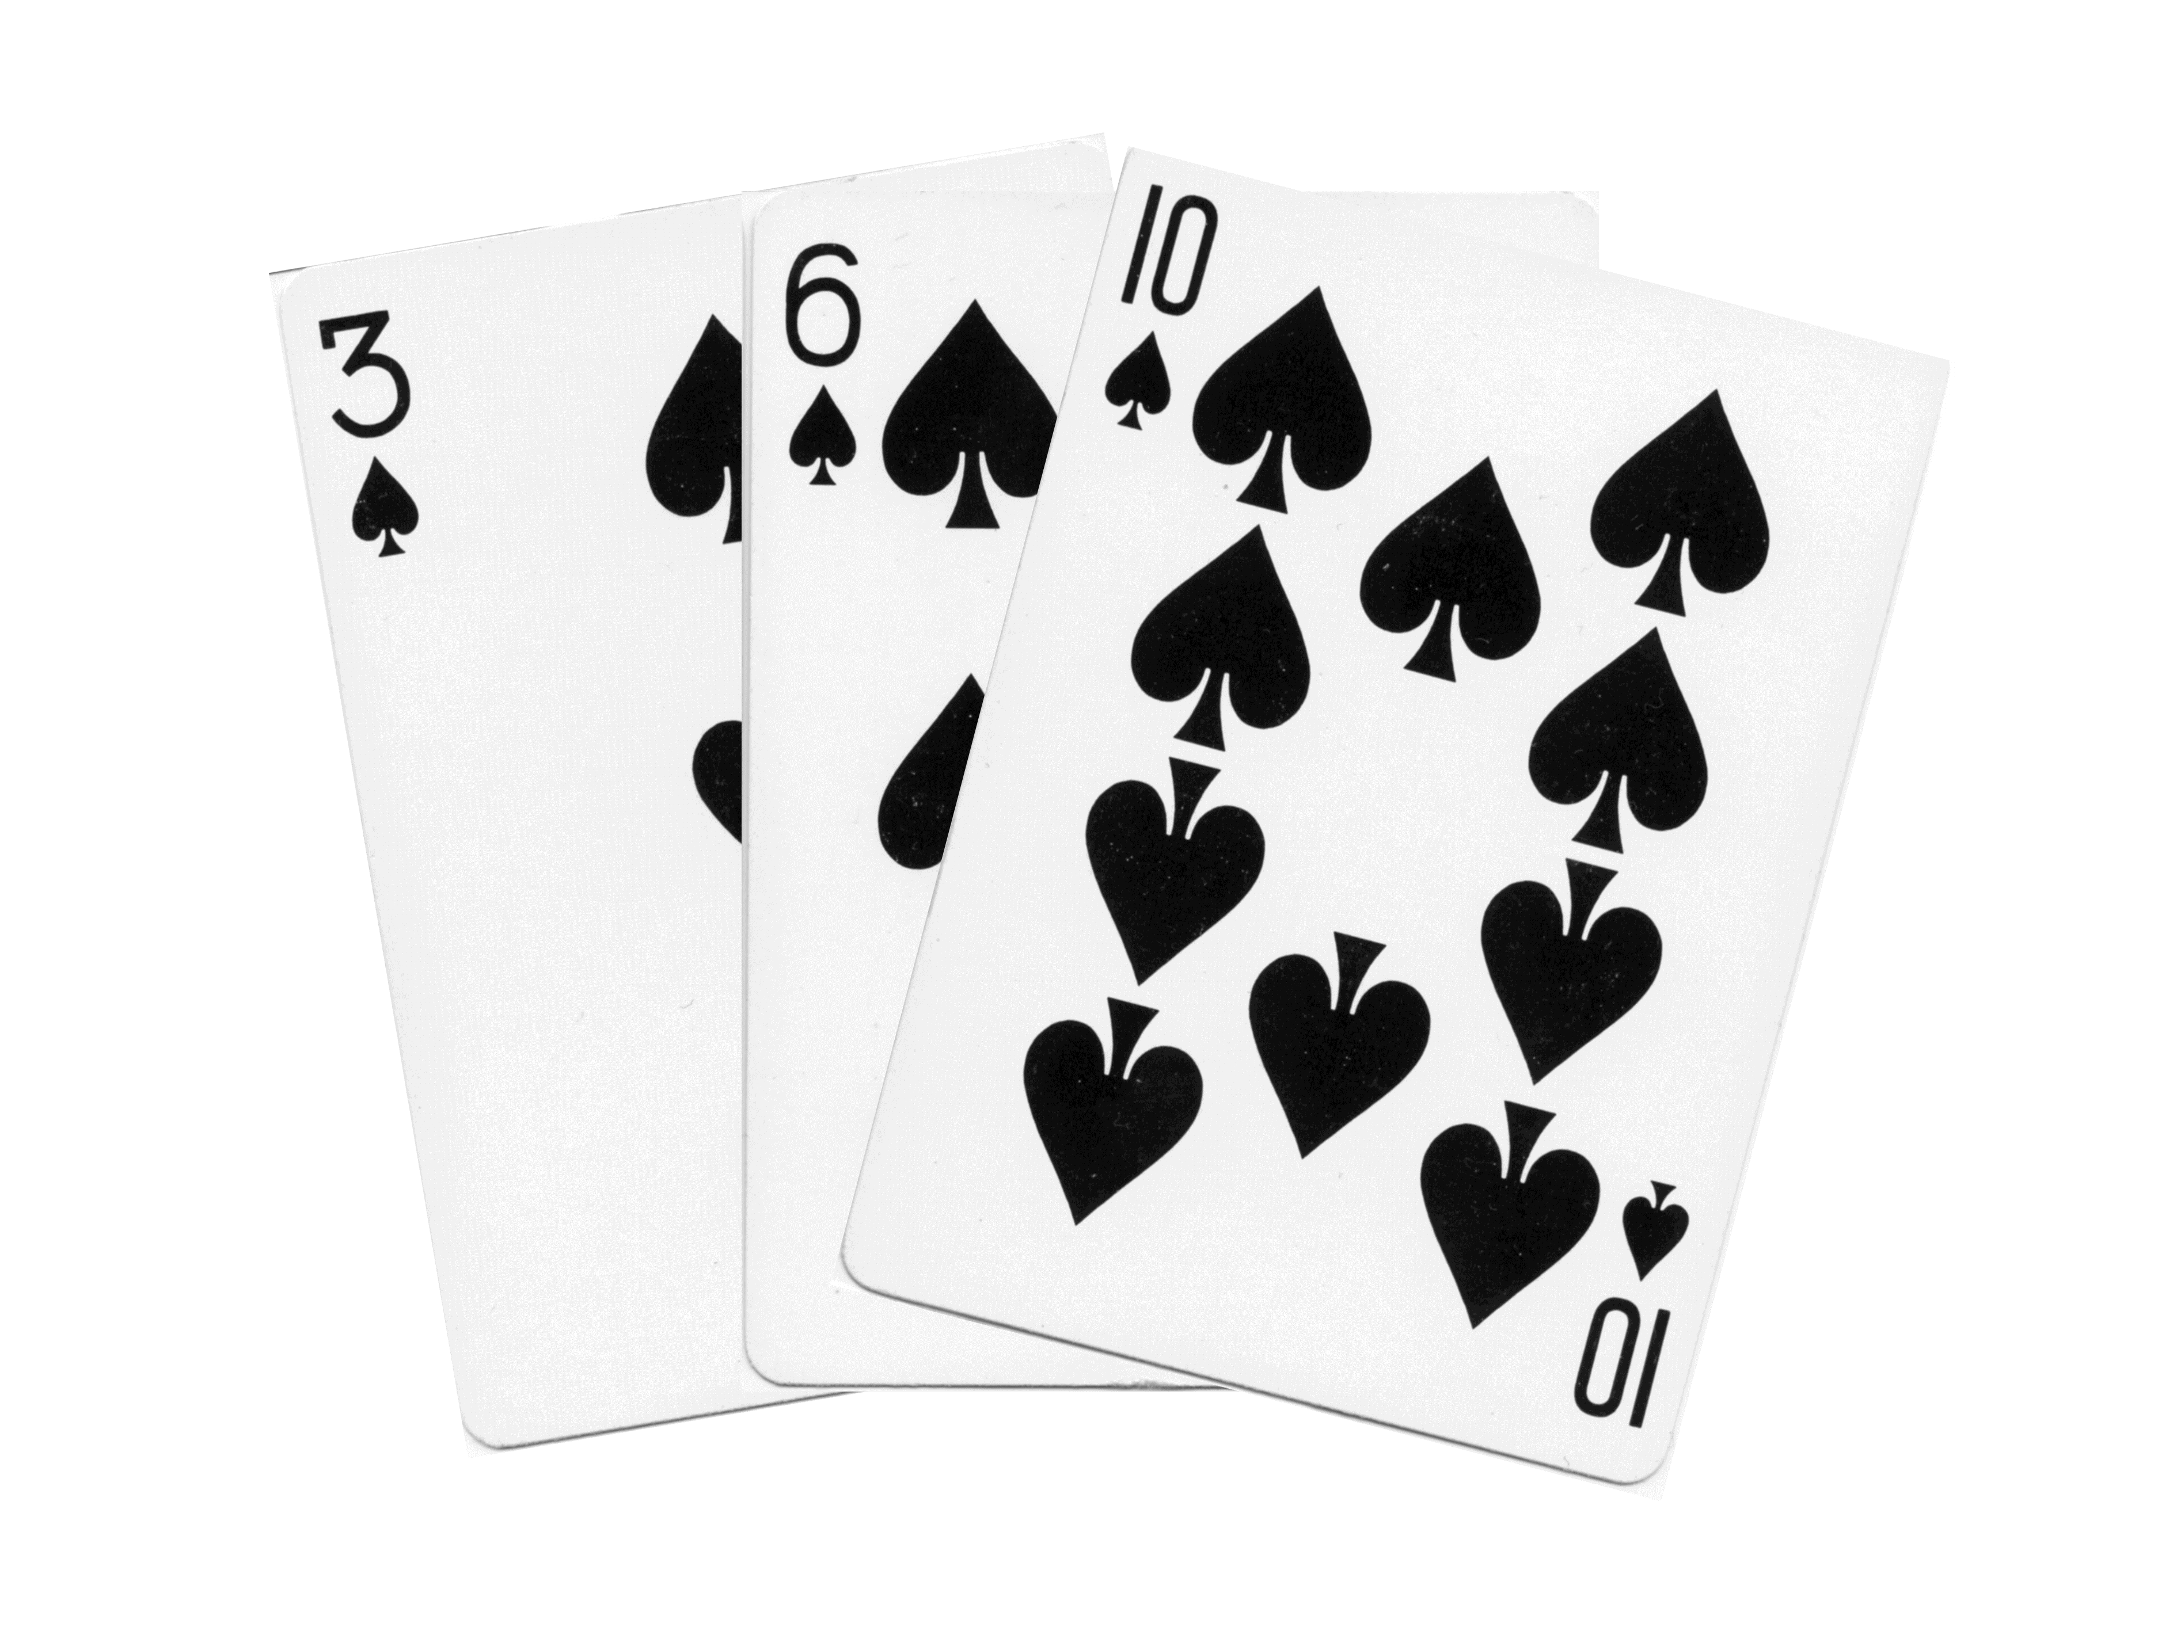
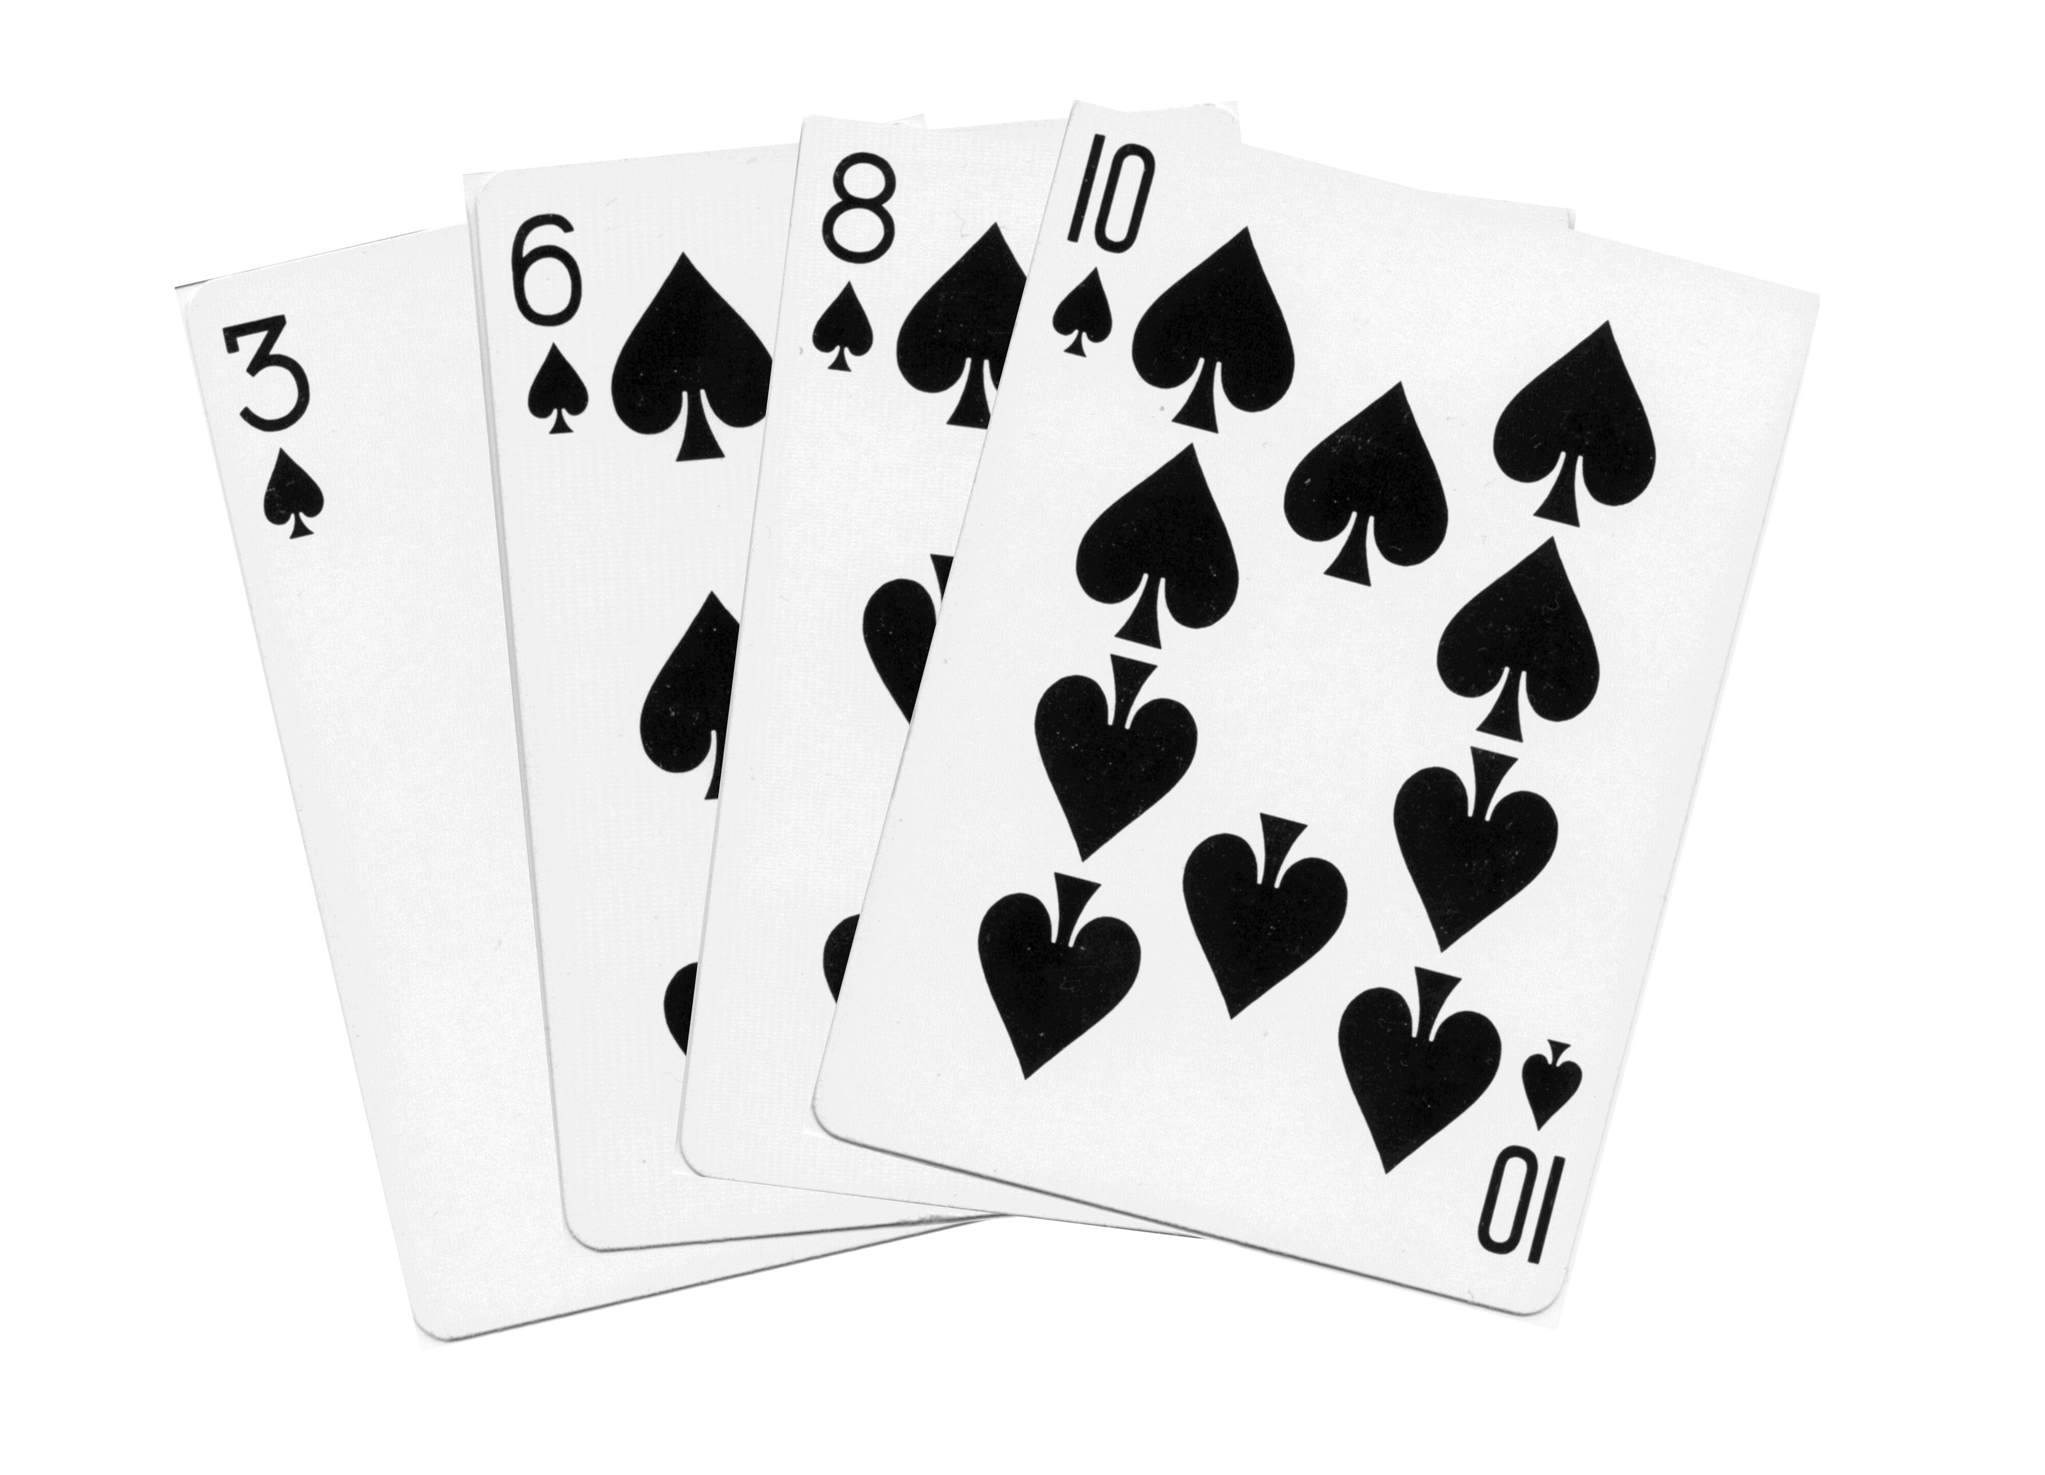
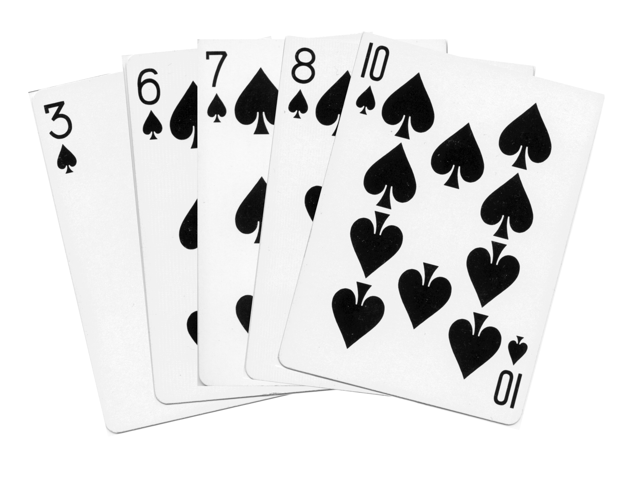
Insertion Sort
Based on technique of card players to arrange a hand
Player keeps cards picked up so far in sorted order
When the player picks up a new card
Makes room for the new card
Then inserts it in its proper place

Slide 14
Insertion Sort Algorithm
For each element from 2nd to last:
Insert element where it belongs in first part of list
Inserting into the sorted part
Increases sorted subarray size by 1
To make room:
Hold value to be inserted in a temp variable
Shuffle elements to the right until gap at right place
Place temp value in the gap

Slide 15
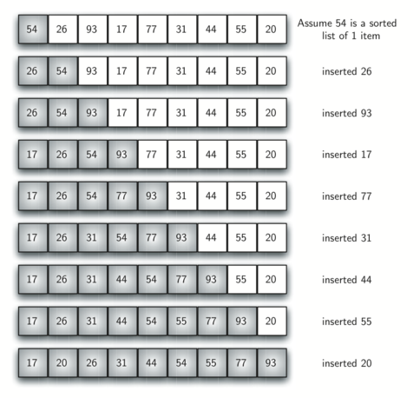
Insertion Sort Example

Slide 16
More Efficient Version
void insertion_sort (int first, int last, int arr[]) {
for (int next_pos = first+1; next_pos != last; next_pos++) {
// elements at position first thru next_pos - 1 are sorted.
// Insert element at next_pos in the sorted subarray.
insert(first, next_pos, arr);
}
}
void insert(int first, int next_pos, int arr[]) {
int next_val = arr[next_pos]; // next_val is element to insert.
while (next_pos != first && next_val < arr[next_pos – 1]) {
arr[next_pos] = arr[next_pos – 1];
next_pos--; // Check next smaller element.
}
arr[next_pos] = next_val; // Store next_val where it belongs.
}
Analysis? Best case? Worst Case?

Slide 17
Analysis of Insertion Sort
Maximum number of comparisons: O(n²)
In the best case, number of comparisons: O(n)
# shifts for an insertion = # comparisons - 1
When new value smallest so far, # comparisons = n
A shift in insertion sort moves only one item
Bubble or selection sort exchange: 3 assignments

Slide 18
Comparison of Quadratic Sorts
Good enough? Can we do better?

Slide 19
Quicksort
Developed in 1962 by C. A. R. Hoare
Given a pivot value:
Rearranges array into two parts:
Left part ≤ pivot value
Right part > pivot value

Slide 20
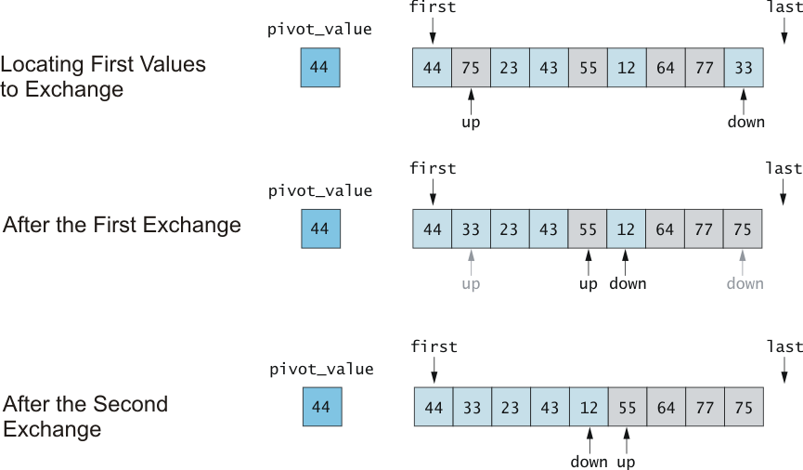
Trace of Algorithm for Partitioning

Slide 21
Quicksort Example
44 | 75 | 12 | 43 | 64 | 23 | 55 | 77 | 33
44 | 33 | 12 | 43 | 23 | 64 | 55 | 77 | 75
23 | 33 | 12 | 43 | 44 | 64 | 55 | 77 | 75
23 | 33 | 12 | 43
64 | 55 | 77 | 75
23 | 12 | 33 | 43
55 | 64 | 77 | 75
12 | 23 | 33 | 43
33 | 43
77 | 75
75 | 77

Slide 22
In English:
Pick a pivot (we picked the first value in each subarray)
Place a firstptr at the first value in the subarray (after the pivot)
Place a lastptr at the last value in the subarray
While the firstptr is less than the lastptr:
While the firstptr is less than the lastptr And the firstptr points to a value less than the pivot
Increment the firstptr to the next value in the array
While the lastptr is greater than the firstptr And the lastptr points to a value greater than the pivot
decrement the lastptr to the previous value in the array
If firstptr < lastptr, switch the values at the firstptr and the lastptr
Switch the values at the pivot and the lastptr
Now the pivot is in place
All values before the pivot become a new subarray and all the values after the pivot become a new subarray
Repeat until subarrays are of length 1 or 2.

Slide 23
Algorithm for Quicksort
first and last are end points of region to sort
if first < last
Partition using pivot, which ends in piv_index
Apply Quicksort recursively to left subarray
Apply Quicksort recursively to right subarray

Slide 24
Algorithm for Partitioning
Set pivot value to a[first]
Set up to first+1 and down to last
do
Increment up until a[up] > pivot or up = last
Decrement down until a[down] <= pivot or
down = first
if up < down, swap a[up] and a[down]
while up is to the left of down
swap a[first] and a[down]
return down as pivIndex

Slide 25
Quicksort Code
void quick_sort(int first, int last int arr[]) {
if (last - first > 1) { // There is data to be sorted.
// Partition the table.
int pivot = partition(first, last, arr);
// Sort the left half.
quick_sort(first, pivot-1, arr);
// Sort the right half.
quick_sort(pivot + 1, last,arr);
}
}

Slide 26
Partitioning Code
int partition(int first, int last, int arr[]) {
int p = first;
int pivot = arr[first];
int i = first+1, j = last;
int tmp;
while (i <= j) {
while (arr[i] < pivot)
i++;
while (arr[j] > pivot)
j--;
if (i <= j) {
tmp = arr[i];
arr[i] = arr[j];
arr[j] = tmp;
i++;
j--;
}
}
return p
};
Analysis? Does this preserve stability? What happens with a sorted list?

Slide 27
Revised Partitioning Algorithm
Average case for Quicksort is O(n log n)
We partition log n times
We compare n values each time (and flip some of them)
Worst case is O(n²)
What would make the worst case happen?
When the pivot chosen always ended up with all values on one side of the pivot
When would this happen?
Sorted list (go figure)

Slide 28
Solution: pick better pivot values
The worst case occurs when list is sorted or almost sorted
To eliminate this problem, pick a better pivot:
Use the middle element of the subarray as pivot.
Use a random element of the array as the pivot.
Perhaps best: take the median of three elements as the pivot.
Use three “marker” elements: first, middle, last
Let pivot be one whose value is between the others

Slide 29
Merge Sort
Like QuickSort in that it involves “divide and conquer” approach
Divide and Conquer usually means O(n log n)
A merge is a common data processing operation:
We’re merging two sets of ordered data
Goal: Combine the two sorted sequences in one larger sorted sequence
Merge sort starts small and merges longer and longer sequences

Slide 30
Merge Algorithm (Two Arrays)
Merging two arrays:
Access the first item from both sequences
While neither sequence is finished
Compare the current items of both
Copy smaller current item to the output
Access next item from that input sequence
Copy any remaining from first sequence to output
Copy any remaining from second to output

Slide 31
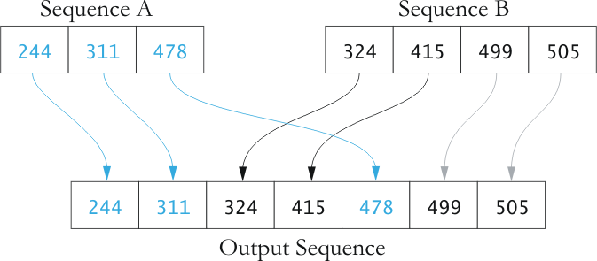
Picture of Merge
Analysis of this? Time? Space?

Slide 32
Analysis of Merge
Two input sequences, total length n elements
Must move each element to the output
Merge time is O(n)
Must store both input and output sequences
An array cannot be merged in place
Additional space needed: O(n)

Slide 33
Using Merge to Sort
So far, we’ve merged 2 files that are already in order.
We can do this in O(n) time – good!
Can we use merge to sort an entire list?
Yes!
Take an unordered list, and divide it into 2 lists
Can we merge these lists?
No – these lists are also unordered.
So let’s divide each of these lists into 2 lists
We continue to divide until each list contains one element
Is a one-element list ordered? Yes!
Now we can start merging lists.
This looks recursive!

Slide 34
Merge Sort Algorithm
Overview:
Split array into two halves
MergeSort the left half (recursively)
MergeSort the right half (recursively)
Merge the two sorted halves
Recursively

Slide 35
Merge Sort Example
50 | 60 | 45 | 30 | 90 | 20 | 80 | 15
50 | 60 | 45 | 30
90 | 20 | 80 | 15
50 | 60
45 | 30
90 | 20
80 | 15
50
60
45
30
90
20
80
15
50 | 60
30 | 45
20 | 90
15 | 80
30 | 45 | 50 | 60
15 | 20 | 80 | 90
15 | 20 | 30 | 45 | 50 | 60 | 80 | 90

Slide 36
Algorithm (in English) for merging
You have two arrays you are going to merge into one array:
Create a new array the length of the two arrays combined
Place a pointer at the beginning of both arrays.
Take the smaller of the two pointer values and place it in the new array.
Increment that pointer value
Continue until pointer in one array is at the end of the array.
Copy remaining of other array to new array
30 | 45 | 50 | 60
15 | 20 | 80 | 90
15 | 20 | 30 | 45 | 50 | 60 | 80 | 90

Slide 37
Merge Sort Code
void merge(int arr[], int l, int m, int r) {
int i, j, k;
int n1 = m - l + 1;
int n2 = r - m;
int L[n1], R[n2]; /* create temp arrays */
for(i = 0; i < n1; i++) /* Copy data to temp arrays L[] and R[] */
L[i] = arr[l + i];
for(j = 0; j < n2; j++)
R[j] = arr[m + 1+ j];
i = 0; /* Merge the temp arrays back into arr[l..r]*/
j = 0;
k = l;
while (i < n1 && j < n2) {
if (L[i] <= R[j]) {
arr[k] = L[i];
i++;
}
else {
arr[k] = R[j];
j++;
}
k++;
}
while (i < n1) {/* Copy the remaining elements of L[], if there are any */
arr[k] = L[i];
i++;
k++;
}
while (j < n2) {/* Copy the remaining elements of R[], if there are any */
arr[k] = R[j];
j++;
k++;
}
}

Slide 38
Merge Sort Analysis
Merging: must go through all the elements in every array for merge
This is O(n)
But we only do this log n times
Merge 1, then 2, then 4, then 8…
So total is O (n log n)
Not bad!
Sorted lists? Reverse order lists?

Slide 39
Selection Algorithm
Selecting the kth largest element
Remember this problem?
How did we do this before
Can you think of one of the algorithms we’ve seen that would also allow us to do this efficiently?

Slide 40
Kth largest:
Quicksort:
the partitioning procedure divides the list into 2 sections, with the pivot in the correct location
(linear time)
In quicksort, we recursively sort both branches, leading to best-case (n log n) time.
If we want the kth largest, do we need to do both sides?

Slide 41
Kth largest
When doing selection, we already know which partition our desired element lies in
the pivot is in its final sorted position
All elements below the pivot are less than the pivot
All elements above the pivot are greater than the pivot
We know how big each section is, and we only have to keep sorting the section with the kth element in it

Slide 42
Partition Based Algorithm
We only need to continue searching through the part that has the kth element in it.
We have 3 cases:
If the pivot is the kth element in the array, return the value at the pivot.
If k is greater than the index of pivot, we need to recurse on the top partition of the array.
If k is less than the index of pivot, we need to recurse on the bottom partition of the array.

